Slide 1

TOP TRUMPS PROJECT
Introduction to Python & Apps Course
Sophie Wenban

Slide 2
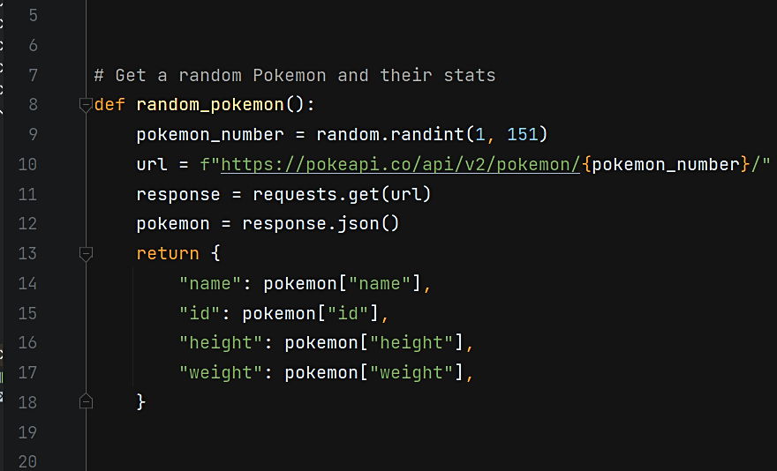
PROJECT BRIEF REQUIREMENTS
1. Generate a random number between 1 and 151 to use as the Pokemon ID number
2. Using the Pokemon API get a Pokemon based on its ID number
3. Create a dictionary that contains the returned Pokemon's name, id, height and weight
Notes:
I have incorporated the brief requirements 1-3 into one function called random_pokemon
Selects a random number in range
Uses the ID no. in an API call to get Pokemon and stats which are put into a dictionary for later use

Slide 3
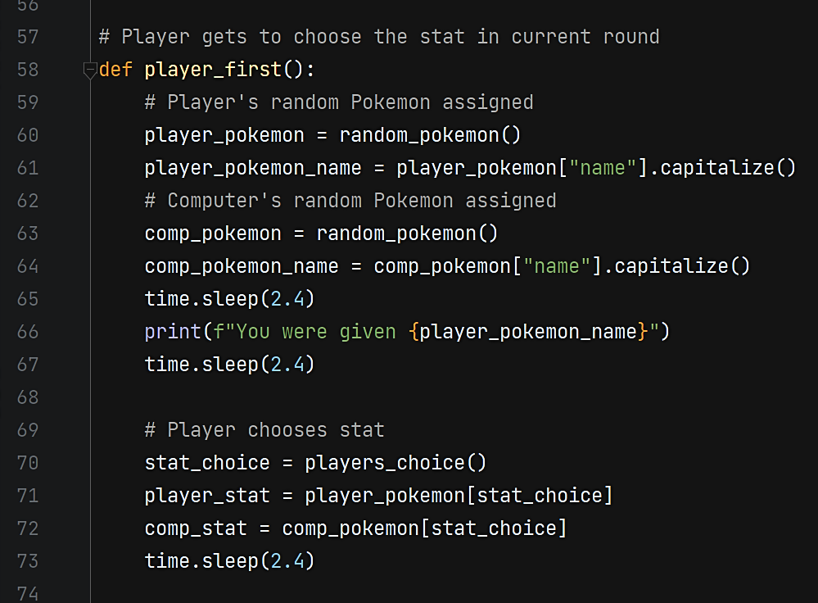
PROJECT BRIEF REQUIREMENTS
4. Get a random Pokemon for the player and another for their opponent
5. Ask the user which stat they want to use (id, height or weight)
Notes:
This next function is called player_first which will make more sense later on
but essentially- it is calling the previous random_pokemon function to assign a random pokemon to a variable for each opponent (point 4)
and the second part of the code calls on the player_choice function to request a stat from the user.

Slide 4
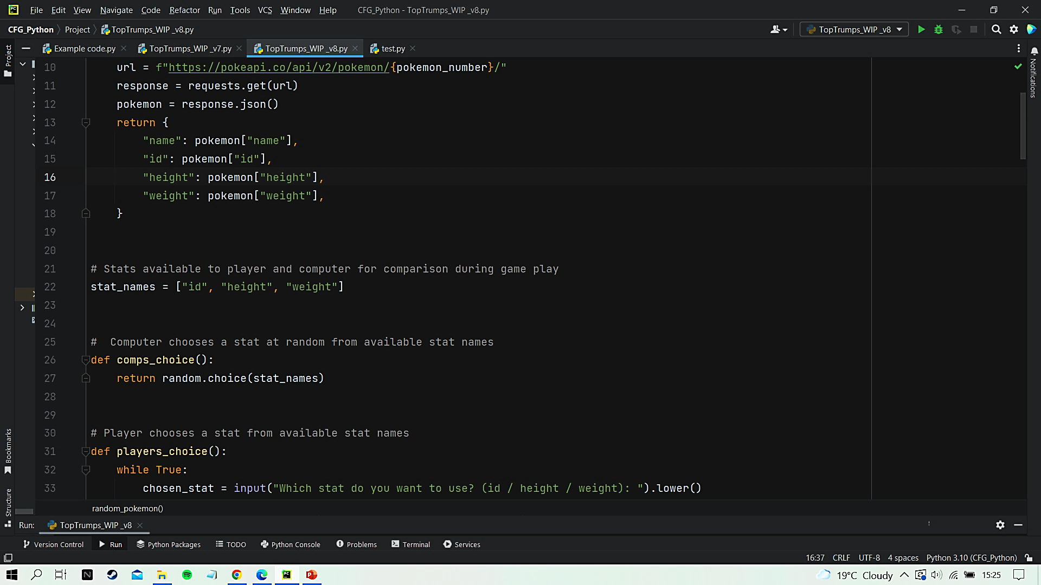
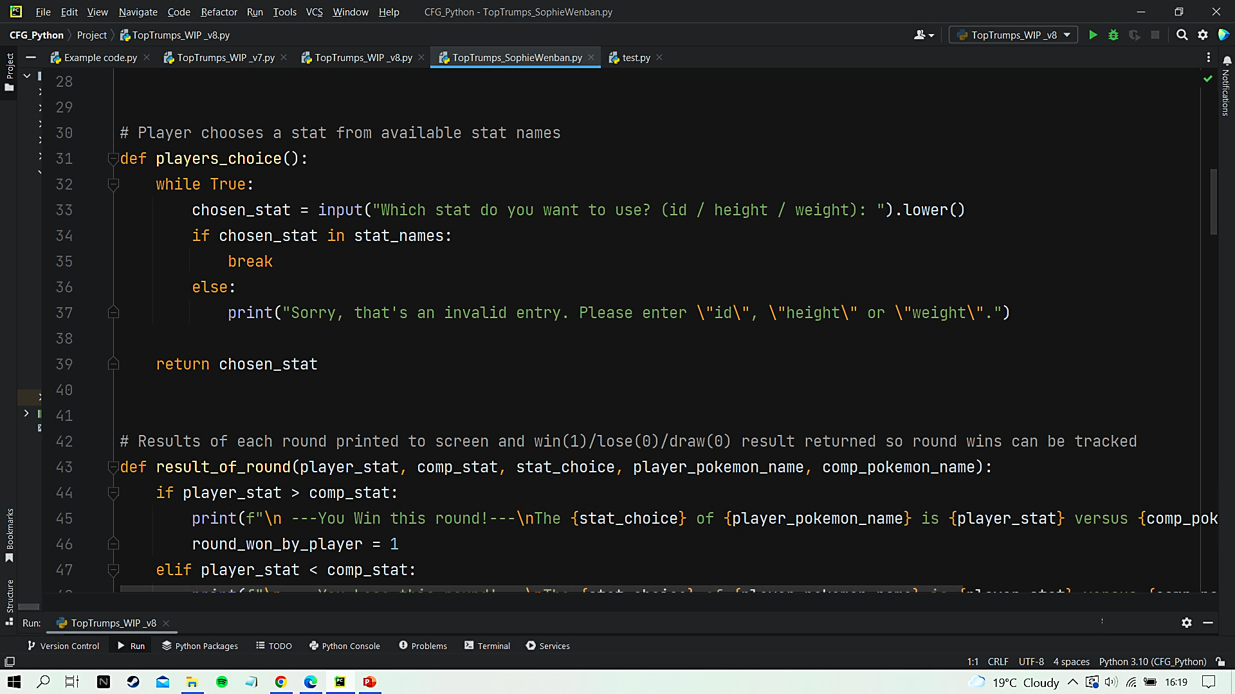
PROJECT BRIEF REQUIREMENTS
5. Ask the user which stat they want to use (id, height or weight)
Notes:
Here is the players_choice function that was being called.
I have used a while loop that checks the user’s input against the list stat_names to ensure only valid inputs are accepted, avoiding game breaking errors.

Slide 5
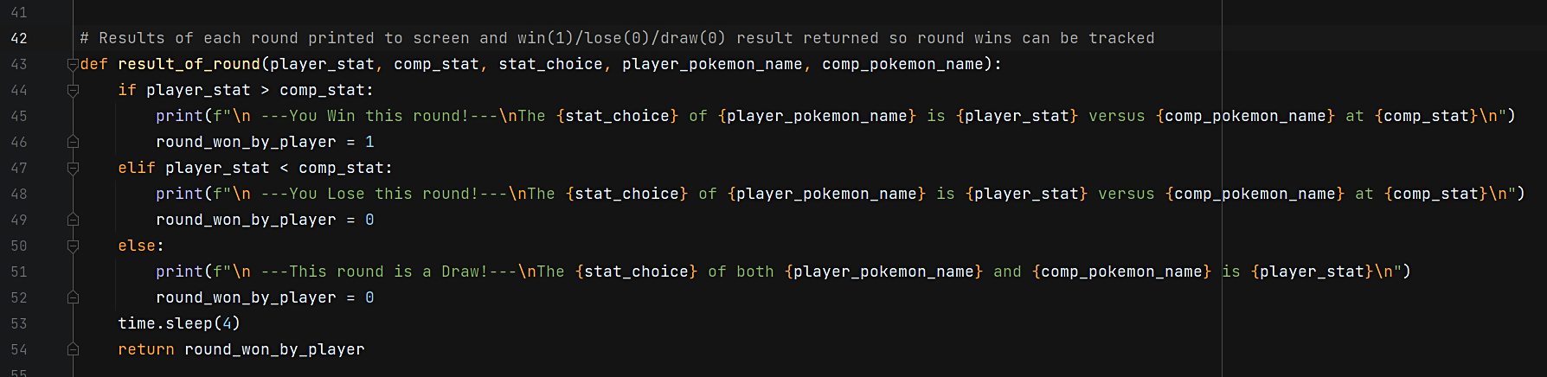
PROJECT BRIEF REQUIREMENTS
6. Compare the player's and opponent's Pokemon on the chosen stat to decide who wins
Notes:
The result_of_round function uses if-elif-else statements to compare the player’s and computer’s stats
and outputs a win, lose or draw message to the console depending on the outcome

Slide 6
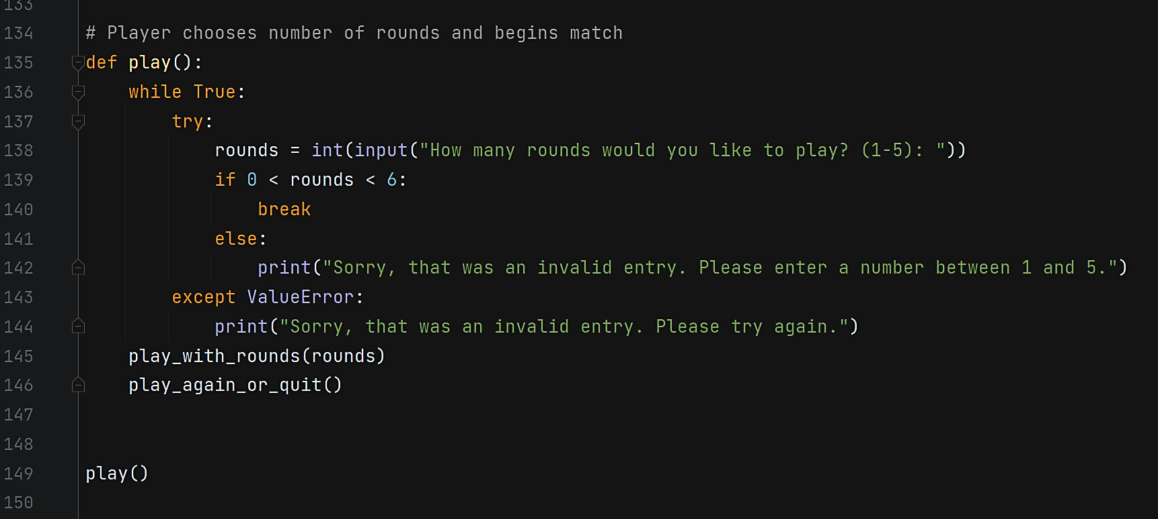
ADDITIONAL FEATURES
Play with rounds
Play again or quit
Notes:
Jumping to the end of the program to demonstrate a couple of additional features.
The play() function allows the user to input the number of rounds they would like to play.
A while loop and try block ensure that only a valid input is accepted aka. an integer from 1-5.
The play_with_rounds() function is then called using the user’s input. We’ll look at this in more detail shortly.
Another new feature is the play_again_or_quit() function which is just as it sounds-
After all rounds are played the user is asked if they would like to play again.

Slide 7
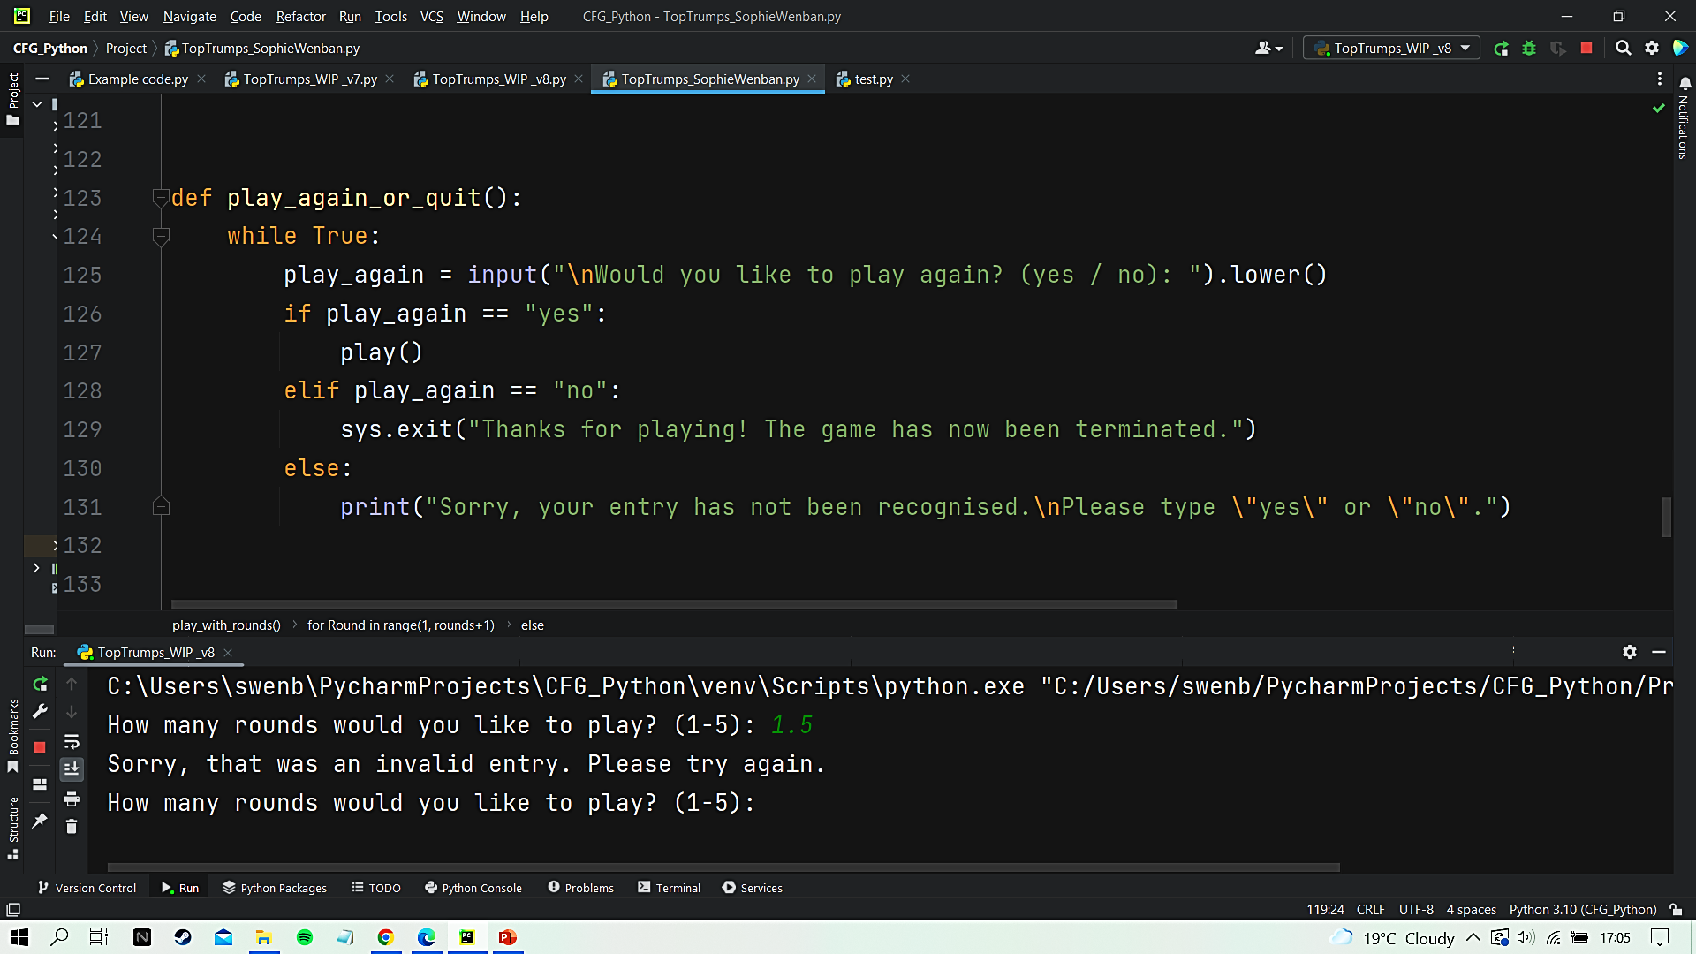
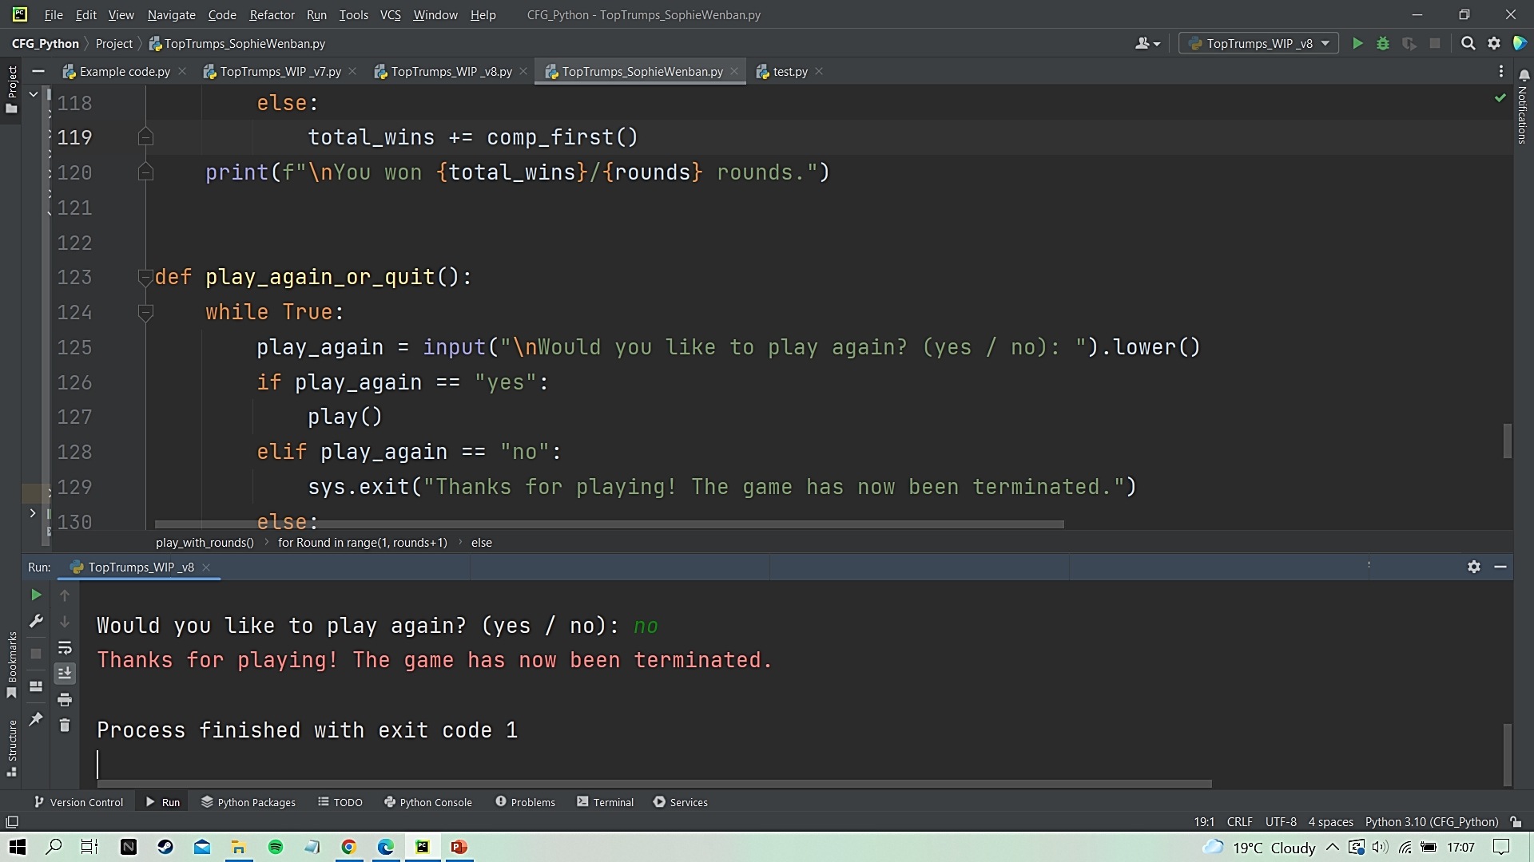
PLAY AGAIN OR QUIT
Console:
Notes:
If the user responds to the request with “no”, the console displays an exit message using sys.exit() function from the sys library.
If “yes”, the play() function is launched again so the player can start another match

Slide 8
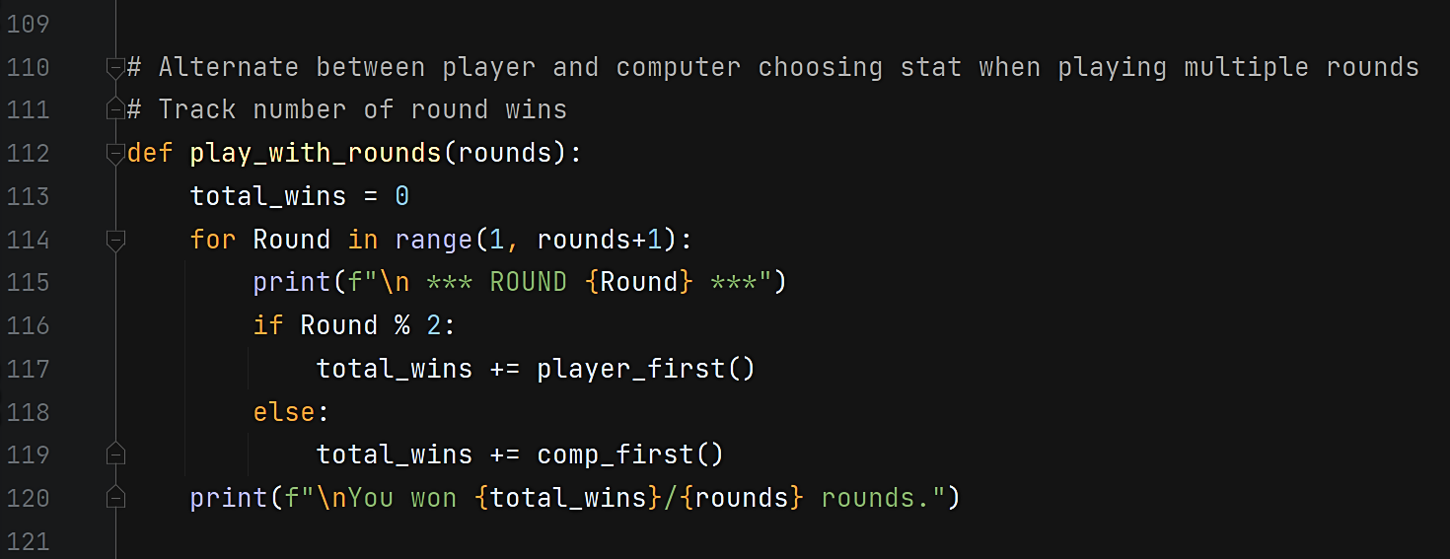
PLAY WITH ROUNDS
Iterates through rounds
Alternates between calling player_first() and comp_first()
Also keeps track of player wins
Notes:
Back to the play_with_rounds() function.
As it iterates through the rounds (as previously chosen by the user) it alternates between 2 functions…

Slide 9
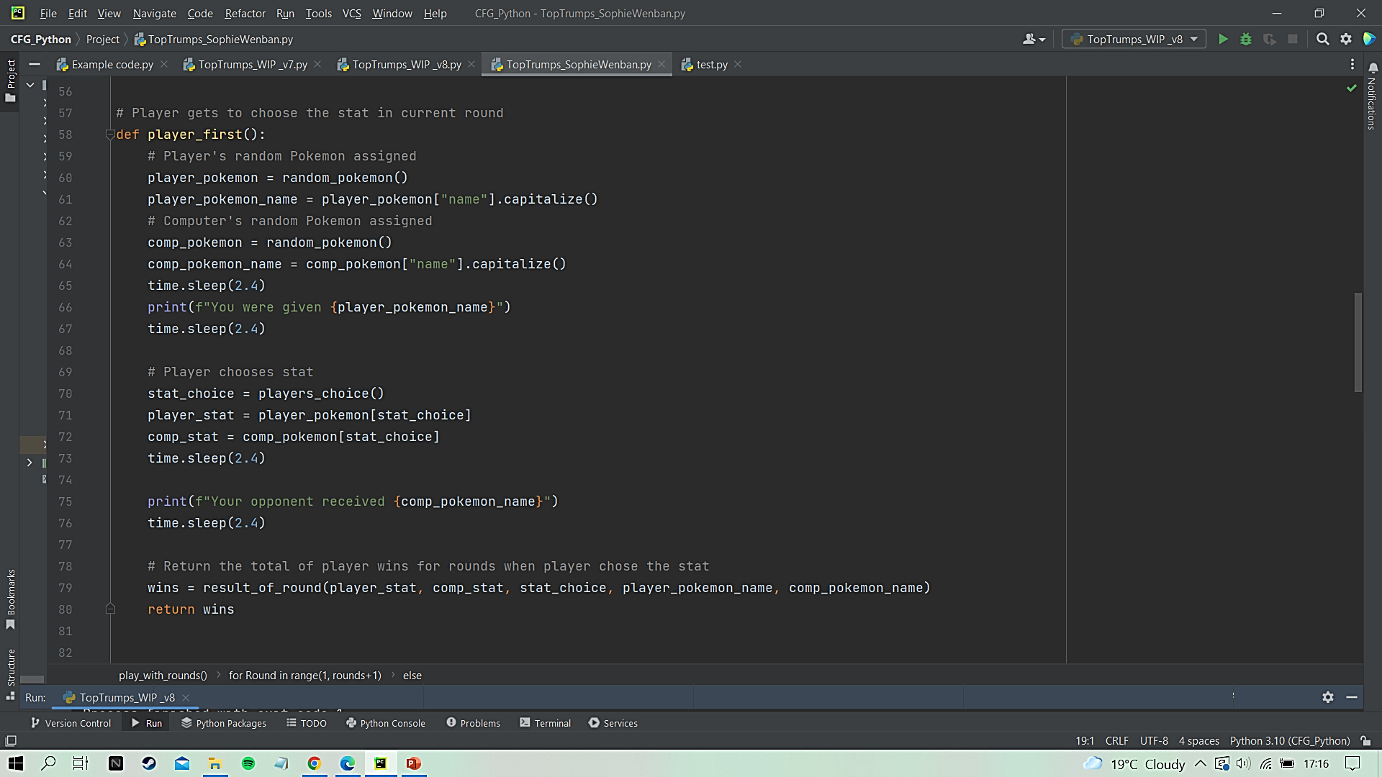
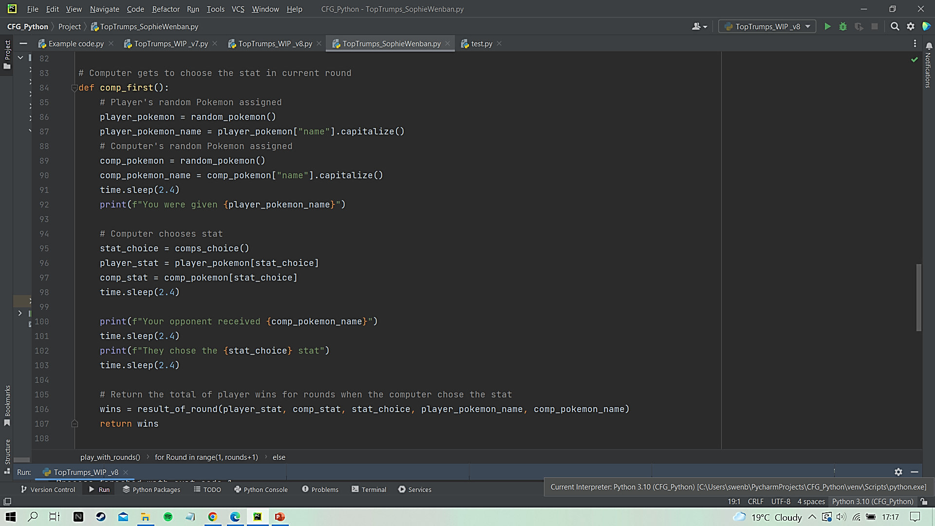
PLAY WITH ROUNDS
Player chooses stat
Computer chooses stat
Notes:
The player_first() function allows the player to choose the stat whereas the comp_first() function allows the computer to choose the stat,
so by alternating which function is called the player and computer take turns.

Slide 10
ADDITIONAL FEATURES
Round scores are tracked and the overall match score is given at the end
Used time.sleep() to slow down the print to console which improves the pacing of the game
Created reusable functions to allow for easier expansions to the game in the future, such as player vs player and multiplayer options

Slide 11

GITHUB - ZoshaCodes
View my project on GitHub:
https://github.com/ZoshaCodes/CodeFirstGirls

